Slide 1
Sales Dashboard
Created by Keerthiha

Slide 2
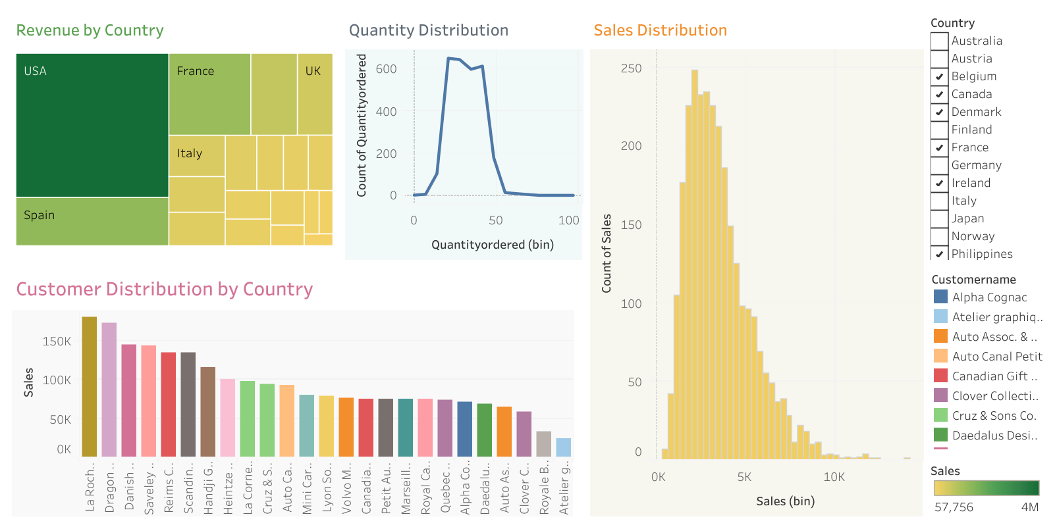
Dashboard 1

Slide 3
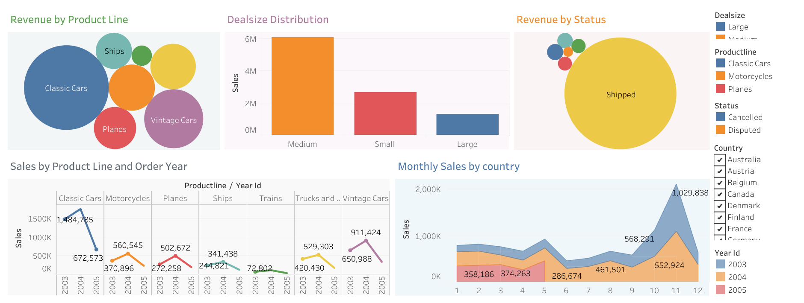
Dashboard 2
Link: https://public.tableau.com/app/profile/keerthiha.manoharan

